Slide 1
Experiment in Compiler Construction Parser design
School of Information and Communication Technology
Hanoi university of technology

Slide 2
Content
Overview
KPL grammar
Parser implementation

Slide 3
Tasks of a parser
Lexical Analysis
Syntax Analysis
Semantic Analysis
Code Generation
Check the syntactic structure of a given program
Syntactic structure is given by Grammar
Invoke semantic analysis and code generation
In an one-pass compiler, this module is very important since this forms the skeleton of the compiler
Notes:
Role of the parser :
In the syntax analysis phase, a compiler verifies whether or not the tokens generated by the lexical analyzer are grouped according to the syntactic rules of the language. This is done by a parser. The parser obtains a string of tokens from the lexical analyzer and verifies that the string can be the grammar for the source language. It detects and reports any syntax errors and produces a parse tree from which intermediate code can be generated.

Slide 4
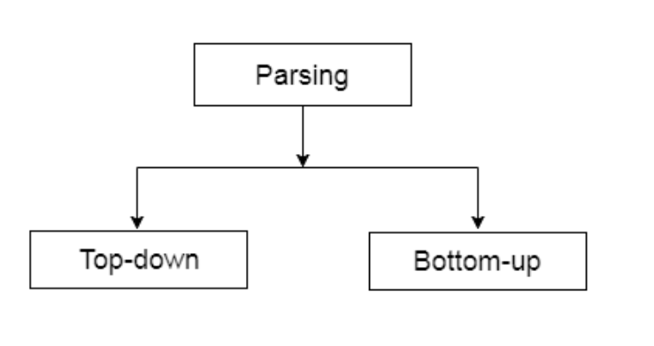
Classification of parsing techniques

Slide 5
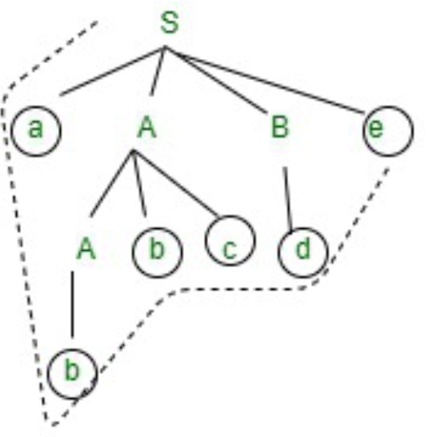
Top down parsing
Construct a parse tree from the root to the leaves, reading the given string from left-to-right
It follows left most derivation.
If a variable contains more than one possibilities, selecting 1 is difficult.
Example: Given grammar G with a set of production rules
G: (1) S → a ABe
(2, 3) A → Abc|b
(4) B → d
input: abbcde
Notes:
Now, you will see that how top down approach works. Here, you will see how you can generate a input string from the grammar for top down approach.
First, you can start with S -> a A B e and then you will see input string a in the beginning and e in the end.
Now, you need to generate abbcde .
Expand A-> Abc and Expand B-> d.
Now, You have string like aAbcde and your input string is abbcde.
Expand A->b.
Final string, you will get abbcde.

Slide 6
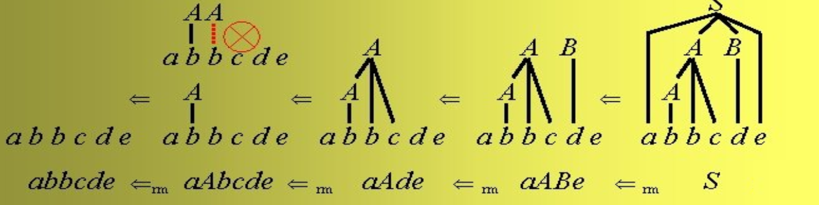
Bottom up parsing
Construct a parse tree from the leaves to the root: left-to-right reduction
It follows the rightmost derivation
Example: Given grammar G with a set of production rules
G: (1) S → a ABe
A → Abc|b
B → d
input: abbcde

Slide 7
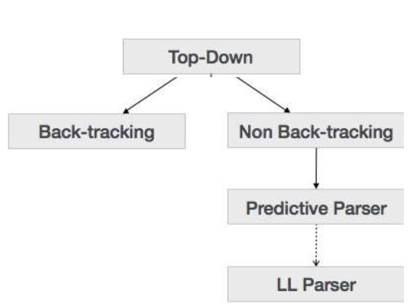
Top down parsing methods

Slide 8
Recursive-descent parsing
A top-down parsing method
Descent: the direction in which the parse tree is traversed (or built).
Use a set of mutually recursive procedures (one procedure for each nonterminal symbol)
Start the parsing process by calling the procedure that corresponds to the start symbol
Each production becomes one branch in procedure for its LHS
We consider a special type of recursive-descent parsing called predictive parsing
Use a lookahead symbol to decide which production to use

Slide 9
Recursive Descent Parsing
For every BNF rule (production) of the form <phrase1> → E the parser defines a function to parse phrase1 whose body is to parse the rule E void compilePhrase1( ) { /* parse the rule E */ }
Where E consists of a sequence of non-terminal and terminal symbols
Requires no left recursion in the grammar.

Slide 10
Parsing a rule
A sequence of non-terminal and terminal symbols, Y₁ Y₂ Y₃ … Y_{n} is recognized by parsing each symbol in turn
For each non-terminal symbol, Y, call the corresponding parse function
compileY
For each terminal symbol, y, call a function eat(y) that will check if y is the next symbol in the source program
The terminal symbols are the token types from the lexical analyzer
If the variable currentsymbol always contains the next token:
eat(y): if (currentsymbol == y)
then getNextToken()
else SyntaxError()

Slide 11
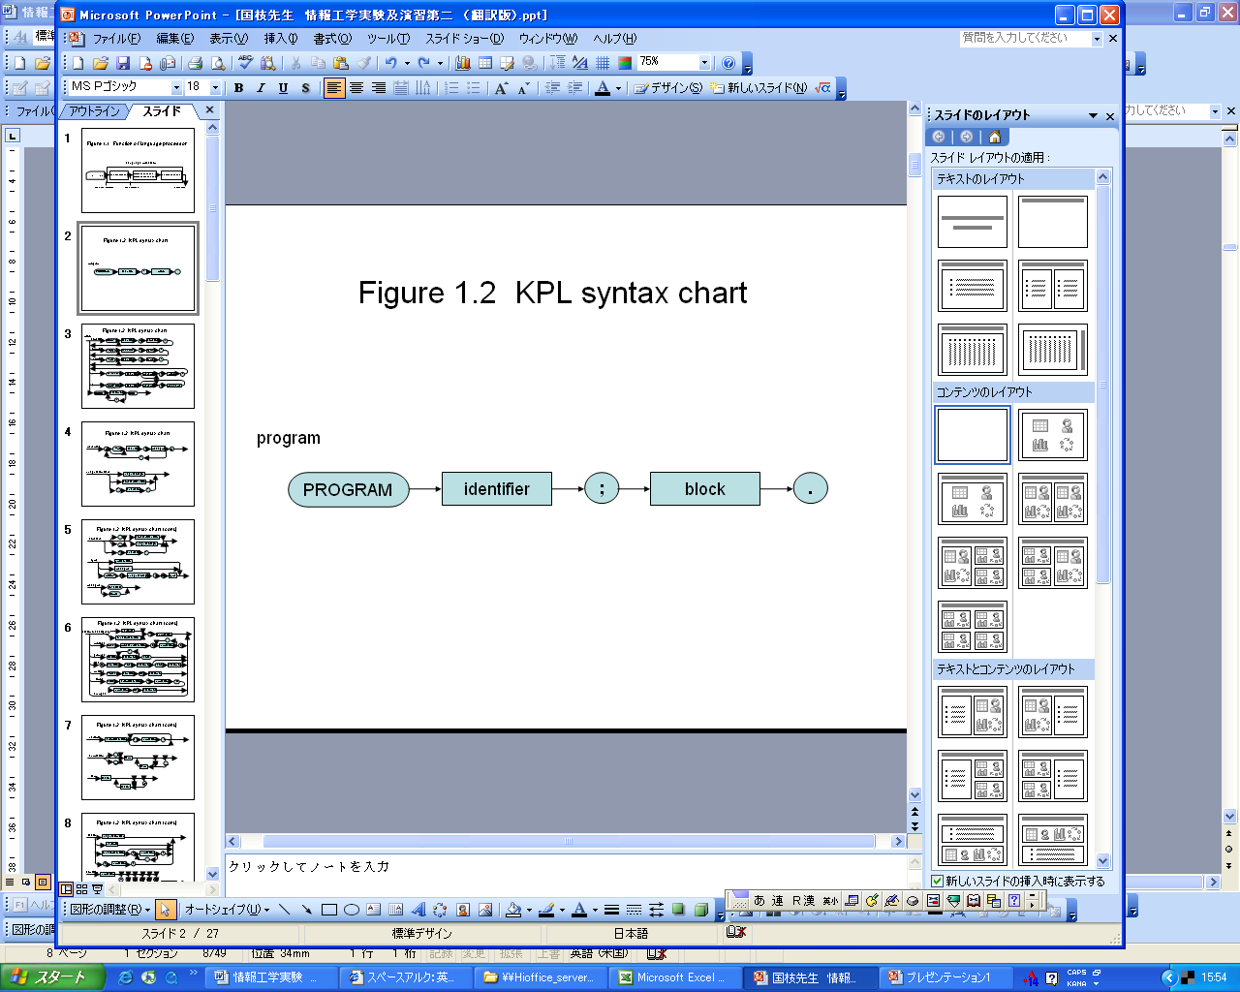
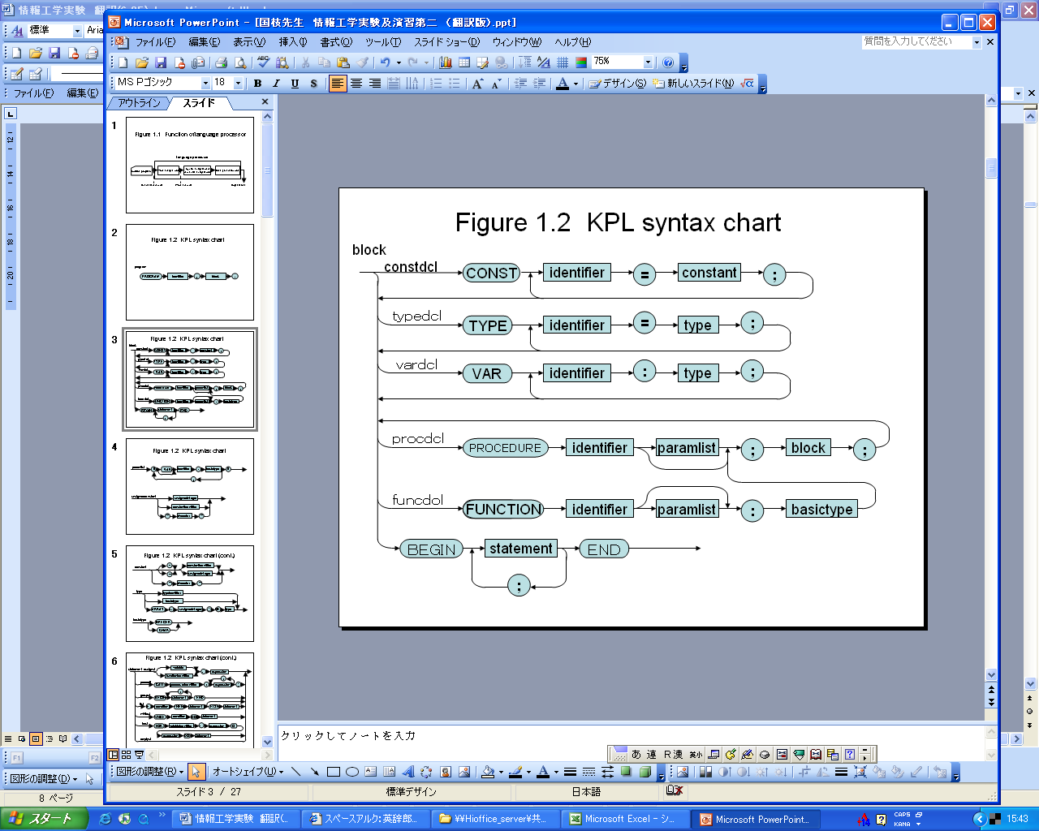
Syntax diagram of KPL

Slide 12
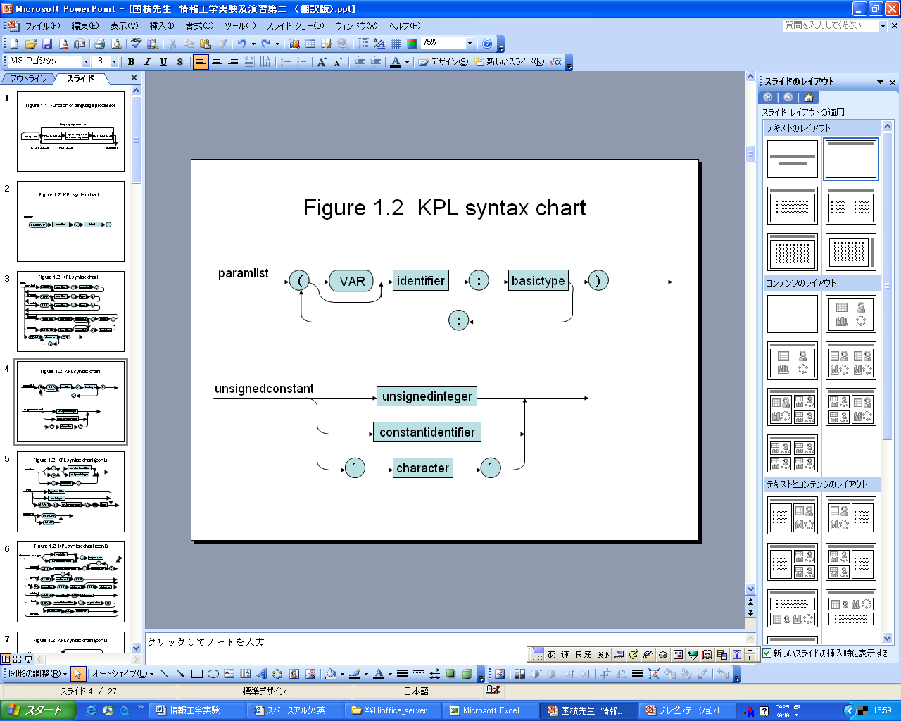
Syntax diagram of KPL

Slide 13
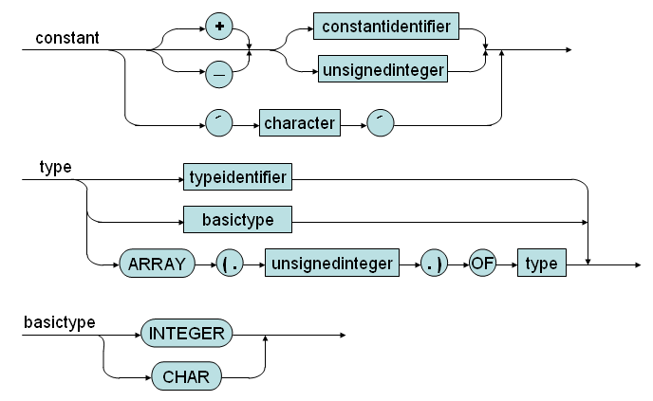
Syntax diagram of KPL

Slide 14
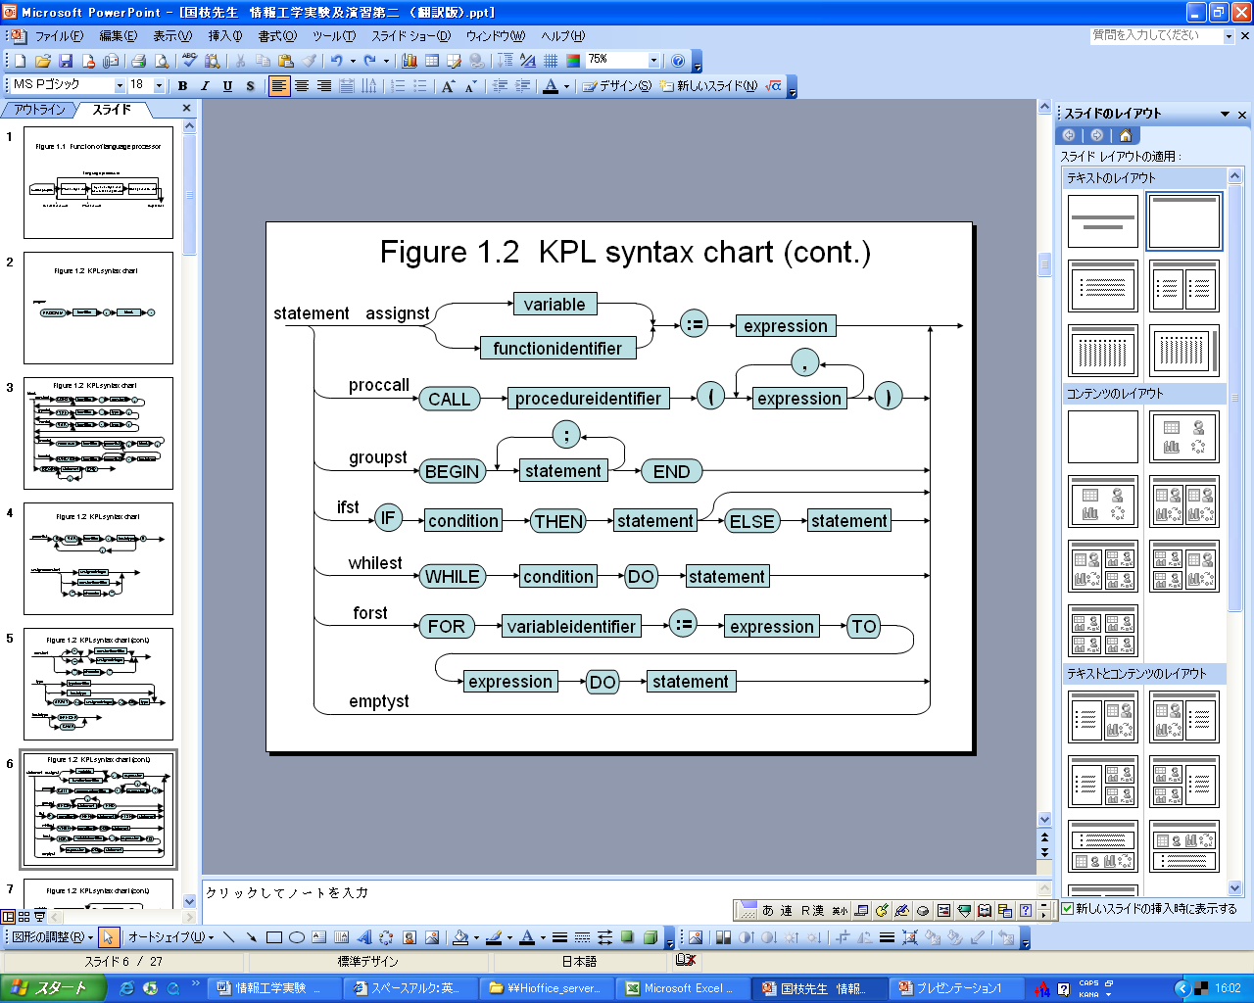
Syntax diagram of KPL

Slide 15
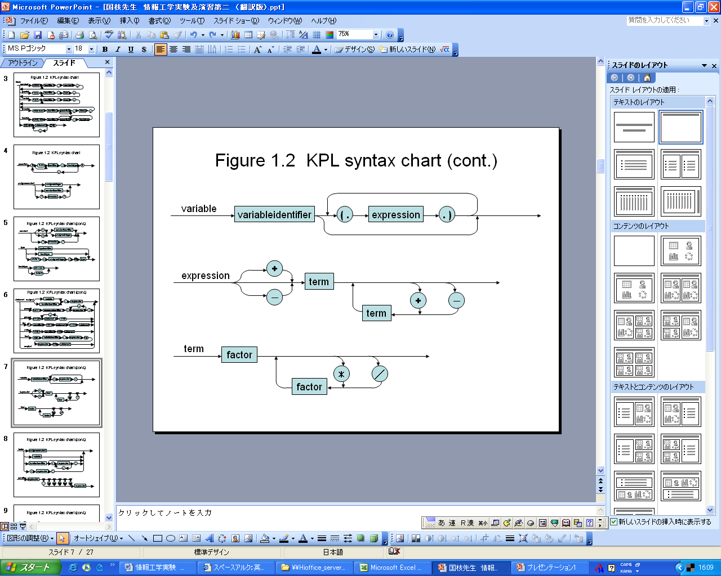
Syntax diagram of KPL

Slide 16
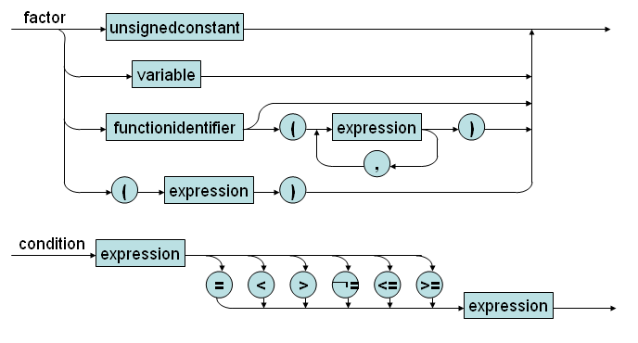
Syntax diagram of KPL

Slide 17
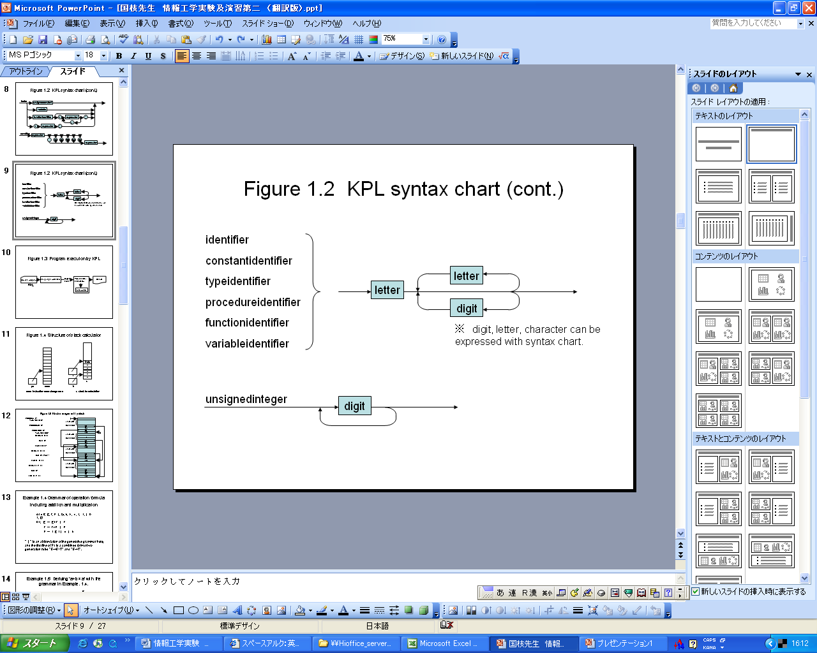
Syntax diagram of KPL

Slide 18
KPL Grammar in BNF
Construct a grammar G based on syntax diagram
Perform left recursive elimination (already)
Perform left factoring

Slide 19
KPL Grammar in BNF
01) <Prog> ::= KW_PROGRAM TK_IDENT SB_SEMICOLON <Block> SB_PERIOD
02) <Block> ::= KW_CONST <ConstDecl> <ConstDecls> <Block2>
03) <Block> ::= <Block2>
04) <Block2> ::= KW_TYPE <TypeDecl> <TypeDecls> <Block3>
05) <Block2> ::= <Block3>
06) <Block3> ::= KW_VAR <VarDecl> <VarDecls><Block4>
07) <Block3> ::= <Block4>
08) <Block4> ::= <SubDecls><Block5>
09) <Block4> ::= <Block5>
10) <Block5> ::= KW_BEGIN <Statements> KW_END
19

Slide 20
KPL Grammar in BNF
11) <ConstDecls>::= <ConstDecl> <ConstDecls>
12) <ConstDecls>::= ε
13) <ConstDecl> ::= TK_IDENT SB_EQUAL <Constant> SB_SEMICOLON
14) <TypeDecls> ::= <TypeDecl> <TypeDecls>
15) <TypeDecls> ::= ε
16) <TypeDecl> ::= TK_IDENT SB_EQUAL <Type> SB_SEMICOLON
17) <VarDecls>::= <VarDecl> <VarDecls>
18) <VarDecls>::= ε
19) <VarDecl> ::= TK_IDENT SB_COLON <Type> SB_SEMICOLON
20) <SubDecls> ::= <FunDecl> <SubDecls>
21) <SubDecls> ::= <ProcDecl> <SubDecls>
22) <SubDecls> ::= ε
20

Slide 21
KPL Grammar in BNF
23) <FunDecl> ::= KW_FUNCTION TK_IDENT <Params> SB_COLON
<BasicType> SB_SEMICOLON <Block> SB_SEMICOLON
24) <ProcDecl> ::= KW_PROCEDURE TK_IDENT <Params> SB_SEMICOLON
<Block> SB_SEMICOLON
25) <Params> ::= SB_LPAR <Param> <Params2> SB_RPAR
26) <Params> ::= ε
27) <Params2> ::= SB_SEMICOLON <Param> <Params2>
28) <Params2> ::= ε
29) <Param> ::= TK_IDENT SB_COLON <BasicType>
30) <Param> ::= KW_VAR TK_IDENT SB_COLON <BasicType>
21

Slide 22
KPL Grammar in BNF
31) <Type> ::= KW_INTEGER
32) <Type> ::= KW_CHAR
33) <Type> ::= TK_IDENT
34) <Type> ::= KW_ARRAY SB_LSEL TK_NUMBER SB_RSEL KW_OF <Type>
35) <BasicType> ::= KW_INTEGER
36) <BasicType> ::= KW_CHAR
37) <UnsignedConstant> ::= TK_NUMBER
38) <UnsignedConstant> ::= TK_IDENT
39) <UnsignedConstant> ::= TK_CHAR
40) <Constant> ::= SB_PLUS <Constant2>
41) <Constant> ::= SB_MINUS <Constant2>
42) <Constant> ::= <Constant2>
43) <Constant> ::= TK_CHAR
44) <Constant2>::= TK_IDENT
45) <Constant2>::= TK_NUMBER
22

Slide 23
KPL Grammar in BNF
46) <Statements> ::= <Statement> <Statements2>
47) <Statements2> ::= SB_SEMICOLON <Statement> <Statements2>
48) <Statements2> ::= ε
49) <Statement> ::= <AssignSt>
50) <Statement> ::= <CallSt>
51) <Statement> ::= <GroupSt>
52) <Statement> ::= <IfSt>
53) <Statement> ::= <WhileSt>
54) <Statement> ::= <ForSt>
55) <Statement> ::= ε
23

Slide 24
KPL Grammar in BNF
56) <AssignSt> ::= <Variable> SB_ASSIGN <Expression>
57) <AssignSt> ::= TK_IDENT SB_ASSIGN <Expression>
58) <CallSt> ::= KW_CALL TK_IDENT <Arguments>
59) <GroupSt> ::= KW_BEGIN <Statements> KW_END
60) <IfSt> ::= KW_IF <Condition> KW_THEN <Statement> <ElseSt>
61) <ElseSt> ::= KW_ELSE <Statement>
62) <ElseSt> ::= ε
63) <WhileSt> ::= KW_WHILE <Condition> KW_DO <Statement>
64) <ForSt> ::= KW_FOR TK_IDENT SB_ASSIGN <Expression> KW_TO
<Expression> KW_DO <Statement>
24

Slide 25
KPL Grammar in BNF
65) <Arguments> ::= SB_LPAR <Expression> <Arguments2> SB_RPAR
66) <Arguments> ::= ε
67) <Arguments2>::= SB_COMMA <Expression> <Arguments2>
68) <Arguments2>::= ε
68) <Condition> ::= <Expression> <Condition2>
69) <Condition2>::= SB_EQ <Expression>
70) <Condition2>::= SB_NEQ <Expression>
71) <Condition2>::= SB_LE <Expression>
72) <Condition2>::= SB_LT <Expression>
73) <Condition2>::= SB_GE <Expression>
74) <Condition2>::= SB_GT <Expression>
25

Slide 26
KPL Grammar in BNF
75) <Expression> ::= SB_PLUS <Expression2>
76) <Expression> ::= SB_MINUS <Expression2>
77) <Expression> ::= <Expression2>
78) <Expression2> ::= <Term> <Expression3>
79) <Expression3> ::= SB_PLUS <Term> <Expression3>
80) <Expression3> ::= SB_MINUS <Term> <Expression3>
81) <Expression3> ::= ε
82) <Term> ::= <Factor> <Term2>
83) <Term2> ::= SB_TIMES <Factor> <Term2>
84) <Term2> ::= SB_SLASH <Factor> <Term2>
85) <Term2> ::= ε
86) <Factor> ::= <UnsignedConstant>
87) <Factor> ::= <Variable>
88) <Factor> ::= <FunctionApptication>
89) <Factor> ::= SB_LPAR <Expression> SB_RPAR
26

Slide 27
KPL Grammar in BNF
90) <Variable> ::= TK_IDENT <Indexes>
91) <FunctionApplication> ::= TK_IDENT <Arguments>
92) <Indexes> ::= SB_LSEL <Expression> SB_RSEL <Indexes>
93) <Indexes> ::= ε
27

Slide 28
Input – output in KPL
Input: Use functions
ReadI: Read an integer. No parameter
ReadC: Read a character. No parameter
Example
var a: integer;
a:= ReadI;
Output: Use procedures
WriteI: Print an integer. 1 parameter
WriteC: Print a character. 1 parameter
WriteLn: Print the newline character.
Example
call WriteI(a);
call WriteLn;

Slide 29
KPL program
Write a function that calculates the square of an integer
Write a program to calculate the sum of the squares of the first n natural numbers. n is read from the keyboard

Slide 30
program example5; (* sum of the squares of the first n natural numbers *) var n : integer;i: integer;sum: integer; function f(k : integer) : integer; begin f := k * k; end; BEGIN n := readI; sum :=0; for i:=1 to n do sum:= sum + f(i); call writeln; call writeI(sum); END. (* example5*)
Solution

Slide 31
Parser implemetation
In general, KPL is a LL(1) grammar
design a top-down parser
lookAhead token
Parsing terminals
Parsing non-terminals
Constructing a parsing table
Computing FIRST() and FOLLOW()
Example
02) Block ::= KW_CONST ConstDecl ConstDecls Block2 =>RHS1
03) Block ::= Block2 =>RHS2
FIRST(RHS1)={KW_CONST}
FIRST(RHS2)={KW_TYPE, KW_VAR, KW_FUNCTION, KW_PROCEDURE,KW_BEGIN}
FIRST(RHS1)∩ FIRST(RHS2)=∅
LookAhead =KW_BEGIN =>RHS2 is chosen =>LL(1)

Slide 32
lookAhead token
Look ahead the next token
Token *currentToken;
Token *lookAhead;
void scan(void) {
Token* tmp = currentToken;
currentToken = lookAhead;
lookAhead = getValidToken();
free(tmp);
}

Slide 33
Parsing terminal symbol
void eat(TokenType tokenType) {
if (lookAhead->tokenType == tokenType) {
printToken(lookAhead);
scan();
} else
missingToken(tokenType, lookAhead->lineNo, lookAhead->colNo);
}

Slide 34
Invoking the parser
int compile(char *fileName) {
if (openInputStream(fileName) == IO_ERROR)
return IO_ERROR;
currentToken = NULL;
lookAhead = getValidToken();
compileProgram();
free(currentToken);
free(lookAhead);
closeInputStream();
return IO_SUCCESS;
}

Slide 35
Parsing non-terminal symbol
Example: Program
1)<Prog>::= KW_PROGRAM TK_IDENT SB_SEMICOLON <Block> SB_PERIOD
void compileProgram(void) {
assert("Parsing a Program ....");
eat(KW_PROGRAM);
eat(TK_IDENT);
eat(SB_SEMICOLON);
compileBlock();
eat(SB_PERIOD);
assert("Program parsed!");
}

Slide 36
Parsing statements
Example: Statement
FIRST(<Statement>) = {TK_IDENT, KW_CALL, KW_BEGIN, KW_IF, KW_WHILE,
KW_FOR, ε}
FOLLOW(<Statement>) = {SB_SEMICOLON, KW_END, KW_ELSE}
/* Predict parse table for Expression */
Input Production
----------------------------------------------------
TK_IDENT 49) <Statement> ::= <AssignSt>
KW_CALL 50) <Statement> ::= <CallSt>
KW_BEGIN 51) <Statement> ::= <GroupSt>
KW_IF 52) <Statement> ::= <IfSt>
KW_WHILE 53) <Statement> ::= <Whilst?
KW_FOR 54) <Statement> ::= <ForSt?
----------------------------------------------------
SB_SEMICOLON 55) ε
KW_END 55) ε
KW_ELSE 55) ε
----------------------------------------------------
Others Error
36

Slide 37
Parsing a statement
Example: Statement
void compileStatement(void) {
switch (lookAhead->tokenType) {
case TK_IDENT:
compileAssignSt();
break;
case KW_CALL:
compileCallSt();
break;
case KW_BEGIN:
compileGroupSt();
break;
case KW_IF:
compileIfSt();
break;
case KW_WHILE:
compileWhileSt();
break;
case KW_FOR:
compileForSt();
break;
// check FOLLOW tokens
case SB_SEMICOLON:
case KW_END:
case KW_ELSE:
break;
// Error occurs
default:
error(ERR_INVALIDSTATEMENT, lookAhead->lineNo, lookAhead->colNo);
break;
}
}
37

Slide 38
LHS with more than 1 RHS
Two alternatives for Basic Type
35) <BasicType> ::= KW_INTEGER
36) <BasicType> ::= KW_CHAR
void compileBasicType(void) {
switch (lookAhead->tokenType) {
case KW_INTEGER:
eat(KW_INTEGER);
break;
case KW_CHAR:
eat(KW_CHAR);
break;
default:
error(ERR_INVALIDBASICTYPE, lookAhead->lineNo, lookAhead->colNo);
break;
}
}

Slide 39
Loop processing
Loop for sequence of constant declarations: Recursion OK, you should process the FOLLOW SET
10) <ConstDecls>::= <ConstDecl> <ConstDecls>
11) <ConstDecls>::= ε
void compileConstDecls(void) {
while (lookAhead->tokenType == TK_IDENT)
compileConstDecl();
}

Slide 40
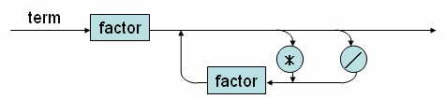
Sometimes you should refer to syntax diagrams
Syntax of Term (using BNF)
82) <Term> ::= <Factor> <Term2>
83) <Term2> ::= SB_TIMES <Factor> <Term2>
84) <Term2> ::= SB_SLASH <Factor> <Term2>
85) <Term2> ::= ε
Syntax of Term (using Syntax Diagram)

Slide 41
Process rules for Term : 2 functions with Follow set checking
case SB_RPAR:
case SB_COMMA:
case SB_EQ:
case SB_NEQ:
case SB_LE:
case SB_LT:
case SB_GE:
case SB_GT:
case SB_RSEL:
case SB_SEMICOLON:
case KW_END:
case KW_ELSE:
case KW_THEN:
break;
default:
error(ERR_INVALIDTERM, lookAhead->lineNo, lookAhead->colNo);
}
}
void compileTerm(void)
{ compileFactor();
compileTerm2();
}
void compileTerm2(void) {
switch (lookAhead->tokenType) {
case SB_TIMES:
eat(SB_TIMES);
compileFactor();
compileTerm2();
break;
case SB_SLASH:
eat(SB_SLASH);
compileFactor();
compileTerm2();
break;
// check the FOLLOW set
case SB_PLUS:
case SB_MINUS:
case KW_TO:
case KW_DO:

Slide 42
Process term with syntax diagram
void compileTerm(void)
{compileFactor();
while(lookAhead->tokenType== SB_TIMES || lookAhead->tokenType == SB_SLASH)
{switch (lookAhead->tokenType)
{
case SB_TIMES:
eat(SB_TIMES);
compileFactor();
break;
case SB_SLASH:
eat(SB_SLASH);
compileFactor();
break;
}
}
}

Slide 43
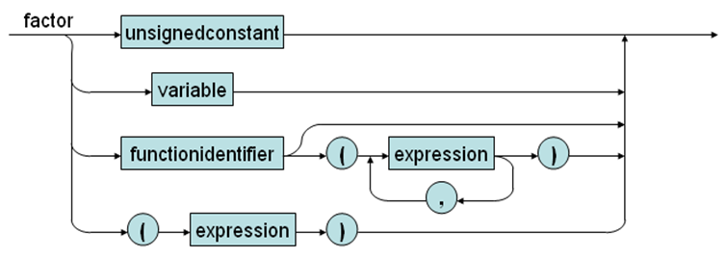
Syntax diagram of factor in KPL
FIRST(unsignedconstant) = {TK_NUMBER, TK_IDENT, TK_CHAR)
FIRST(variable) = {TK_IDENT}
FIRST(functioncall) = {TK_IDENT}
FIRST(unsignedconstant) ∩ FIRST(functioncall) = {TK_IDENT)
FIRST(variable) ∩ FIRST(functioncall) = {TK_IDENT}
FIRST(variable) ∩ FIRST(unsignedconstant)}= {TK_IDENT}
=>violation of LL(1) condition

Slide 44
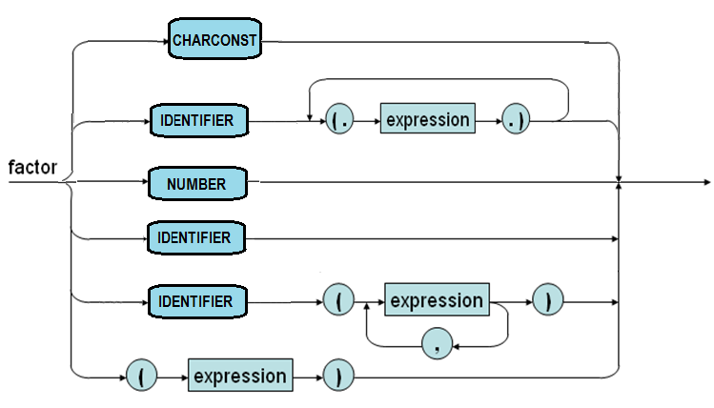
After separating and merging

Slide 45
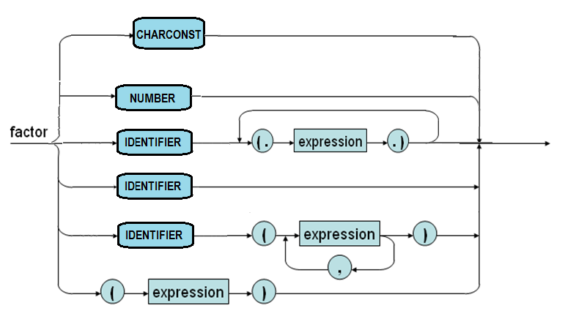
Compile a factor
void compileFactor(void) {
switch (lookAhead->tokenType) {
case TK_NUMBER:
eat(TK_NUMBER);
break;
case TK_CHAR:
eat(TK_CHAR);
break;
case TK_IDENT:
eat(TK_IDENT);
switch (lookAhead->tokenType) {
case SB_LSEL:
compileIndexes();
break;
case SB_LPAR:
compileArguments();
break;
default: break;
}
break;
case SB_LPAR:
eat(SB_LPAR);
compileExpression();
eat(SB_RPAR);
break;
default:
error(ERR_INVALIDFACTOR, lookAhead->lineNo, lookAhead->colNo);
}
}

